Slide 1
Predicates and Quantifiers

Slide 2
PROPOSITIONAL FUNCTION (open sentence)
Statement involving one or more variables e.g.: x > 5.
This statement has two parts .
First part: The variable x which is the subject
Second part: The predicate ‘ greater than 5’
Propositional function is represented by P(x) where P is the predicate and x is the variable.
If a value is assigned to the variable x, then P(x) becomes a proposition.
What is the truth value of P(2) ?
What is the truth value of P(9) ?
False
True

Slide 3
Consider the propositional function Q(x, y, z) defined by:
x + y = z.
Here, Q is the predicate and x, y, and z are the variables.
What is the truth value of Q(2, 3, 5) ?
What is the truth value of Q(0,1,2) ?
QUANTIFIER
A quantifier is an operator used to create a proposition from a propositional function.
True
False

Slide 4
UNIVERSAL QUANTIFIER
Let P(x) be a propositional function. The Universal quantification of P(x) is the proposition
“ P(x) is true For all values of x in the universe of discourse”.
Why is it important to specify Universe of Discourse?
Let x = the character ‘a’
Is ‘a’+1 > ‘a’?
Let x = the state of Pakistan
Is Pakistan+1 > Pakistan?
You need to specify your universe!

Slide 5
Notation: ∀x P(x) “for all x P(x)” or “for every x P(x)”
The universal quantification ∀x P(x) implies:
P(x₁) ∧ P(x₂) ∧ … ∧ P(x_{n})
∀x P(x) is either true or false, so it is a proposition, not a propositional function.

Slide 6
What is the truth value of ∀x P(x), where P(x) is the statement “x² <10” and the universe of discourse consists of positive integers not exceeding 4?
False
What is the truth value of ∀x (x² ≥ x) ” if the universe of discourse consists of i) all real numbers ii) all integers?
i) False
ii) True

Slide 7
Existential quantification
Let P(x) be a propositional function. The Existential quantification of P(x) is the proposition “There exists a value of x in the universe of discourse such that P(x) is true ”.
Notation : ∃x P(x)
The existential quantification ∃x P(x) implies:
P(x₁) ∨ P(x₂) ∨ … ∨ P(x_{n})
What is the truth value of ∃x P(x), where P(x) is the statement “x² <10” and the universe of discourse consists of positive integers not exceeding 4?
True

Slide 8
Let P(x) = x+1 > x
“for at least one value of x, x+1>x is true”
“for all values of x, x+1>x is true”
In order to show an existential quantification is true, you only have to find ONE value
In order to show an existential quantification is false, you have to show it’s false for ALL values
x P(x) :
x P(x) :

Slide 9
Let the universe of discourse be the real numbers.
What does ∀x∃y (x + y = 320) mean ?
“For every x there exists a y so that x + y = 320.”
Is it true?
Is it true for natural numbers?
Yes
No

Slide 10
Binding Variables
The occurrence of a variable is said to be bound when either a quantifier is used on the variable x or a value is assigned to it.
(∃x P(x)) ∨ Q(x))
The x in Q(x) is not bound; thus not a proposition
(∃x P(x)) ∨ (∀x Q(x))
Both x values are bound; thus it is a proposition
(∃x P(x) ∧ Q(x)) ∨ (∀y R(y))
All variables are bound; thus it is a proposition
(∃x P(x) ∧ Q(y)) ∨ (∀y R(y))
The y in Q(y) is not bound; this not a proposition

Slide 11
Translate the following statement using quantifiers “For every student in this class, that student has studied calculus”
Rephrased: “For every student x in this class, x has studied calculus”
Let C(x) be “x has studied calculus”
Let S(x) be “x is a student in this class”
∀x C(x)
Truth Value: True if the universe of discourse is all students in this class
What about if the universe of discourse is all students (or all people?)
∀x (S(x)∧C(x))
This is wrong! Why?
∀x (S(x)→C(x))

Slide 12
Translate the following statement using quantifiers “Some students in this class have visited Mexico”
Let:
S(x) be “x is a student in this class”
M(x) be “x has visited Mexico”
Rephrasing: “There exists a student who has visited Mexico”
∃x M(x)
Truth Value: True if the universe of discourse is all students
What about if the universe of discourse is all people?
∃x (S(x) → M(x))
This is wrong! Why?
∃x (S(x) ∧ M(x))

Slide 13
Consider: “Every student in this class has visited Canada or Mexico”
S(x) be “x is a student in this class”
M(x) be “x has visited Mexico”
C(x) be “x has visited Canada”
∀x (M(x)∨C(x)
When the universe of discourse is all students
∀x (S(x)→(M(x)∨C(x))
When the universe of discourse is all people
Why isn’t ∀x (S(x)∧(M(x)∨C(x))) correct?

Slide 14
NEGATING QUANTIFICATIONS
To negate a universal quantification:
You negate the propositional function
AND you change to an existential quantification
¬∀x P(x) = ∃x ¬P(x)
To negate An existential quantification:
You negate the propositional function
AND you change to a universal quantification
¬ ∃ x P(x) = ∀ x ¬P(x)

Slide 15
Every student in this class has taken calculus
Negation: There is a student in this class who has not taken a course in calculus
There is a student in this class who has taken a course in calculus.
Negation: Every student in this class has not taken calculus
What are the negations of the statements ∀x (x² >x)
and ∃x (x² =2)
i) ∃x (x² ≤x)
ii) ∀ x (x² ≠2)

Slide 16
Translate the statements:
“All hummingbirds are richly colored”
“No large birds live on honey”
“Birds that do not live on honey are dull in color”
“Hummingbirds are small”
Assign our propositional functions
Let P(x) be “x is a hummingbird”
Let Q(x) be “x is large”
Let R(x) be “x lives on honey”
Let S(x) be “x is richly colored”
Let our universe of discourse be all birds

Slide 17
“All hummingbirds are richly colored”
∀x (P(x)→S(x))
“No large birds live on honey”
¬∃x (Q(x) ∧ R(x))
Alternatively: ∀x (¬Q(x) ∨ ¬R(x))
“Birds that do not live on honey are dull in color”
∀x (¬R(x) → ¬S(x))
“Hummingbirds are small”
∀x (P(x) → ¬Q(x))

Slide 18
Translating statements involving Nested Quantifiers
For the following the universe of discourse is real numbers
Commutative law for addition:
Associative law for addition:
Existence of Additive inverse:
The product of a positive and negative real number is negative:
Find the negation of ∀x ∃y(xy=1)
∃ x ∀ y(xy≠1)
x y(x+y=y+x)
x y z(x+(y+z)=(x+y)+z)
x y(x+y=0)
x y((x>0) (y<0) → (xy<0))

Slide 19
Translate the following statement into english
∀x (C(x) ∨ ∃y(C(y) ∧ F(x,y))) where C(x) is “x has a computer” and F(x,y) is “ x and y are friends”.
Universe of discourse is all students in school
For every student x in your school x has a computer or there is a student y such that has a computer and x and y are friends.
(Every student in your school has a computer or has a friend who has a computer)

Slide 20
ORDER OF QUANTIFIERS
Is order of quantifiers important?
Yes! unless all quantifiers are universal quantifiers or all are existential quantifiers
∀x∀y P(x, y) vs. ∀y∀x P(x, y)
P(x,y): “x+y=y+x”
∀x ∃y Q(x, y) vs. ∃y∀x Q(x, y)
Q(x,y): “x+y=0”

Slide 21
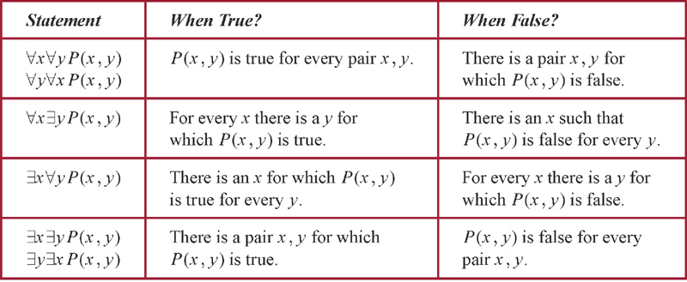
Table : Quantification of Two variables
Notes:
p:\msoffice\My Projects\Rosen 6e 2007\Imagebank\JPEGs07-24-06\ch01\jpeg\t01_4_001.jpg

